Slide 1



Wordsmith
Presented by- Kashish Sharma Submitted to – Mr. Kunal Goyal

Slide 2
Introduction
The world where we live now is facing more issues related to career choices and being alone due to the pandemic that we are facing. Pursuing your passion or dreams, especially when they are not exciting your family, is a difficult choice to make.
This project is built as an initiative for the comfort of the people who loves to write but due to their involvement other things like household, job and business have lost their interest.
In this world of pandemic, people are suffering a lot due to the loss of their dear ones, financial crisis or depression; this project will help them get indulged in an activity they love to escape out from their problems for some time and have some me time

Slide 3
Features
User will be able to choose which genre they would like to write.
User experience nice visuals.
User can have random quote automatically generated.
User can easily write content..

Slide 4
Technology used
HTML
CSS
JAVASCRIPT
BOOTSTRAP

Slide 5
Front end technology
HTML :- HTML is used to display content of website or software on browser .
CSS(Cascading Style Sheets) :- CSS are used to styling a html page and provide attractive layout and for effective designs.
JavaScript :- It is a used to give dynamic functionalities to our Html page.

Slide 6
Screenshots

Slide 7
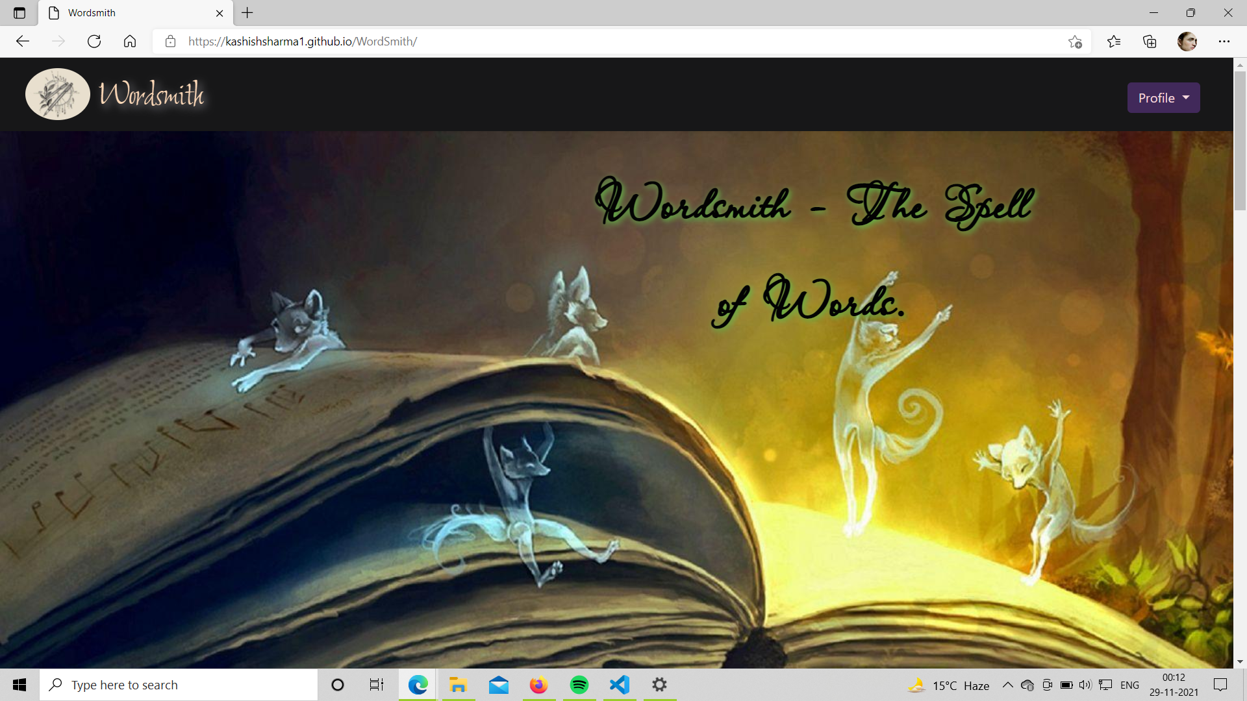

Slide 8
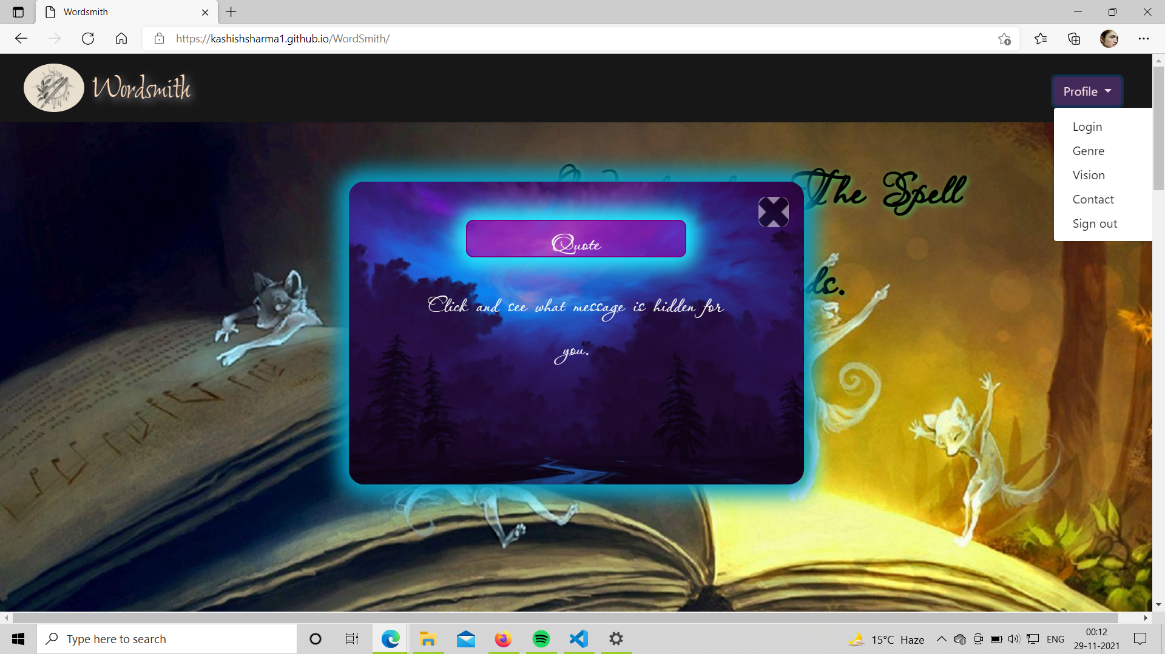

Slide 9
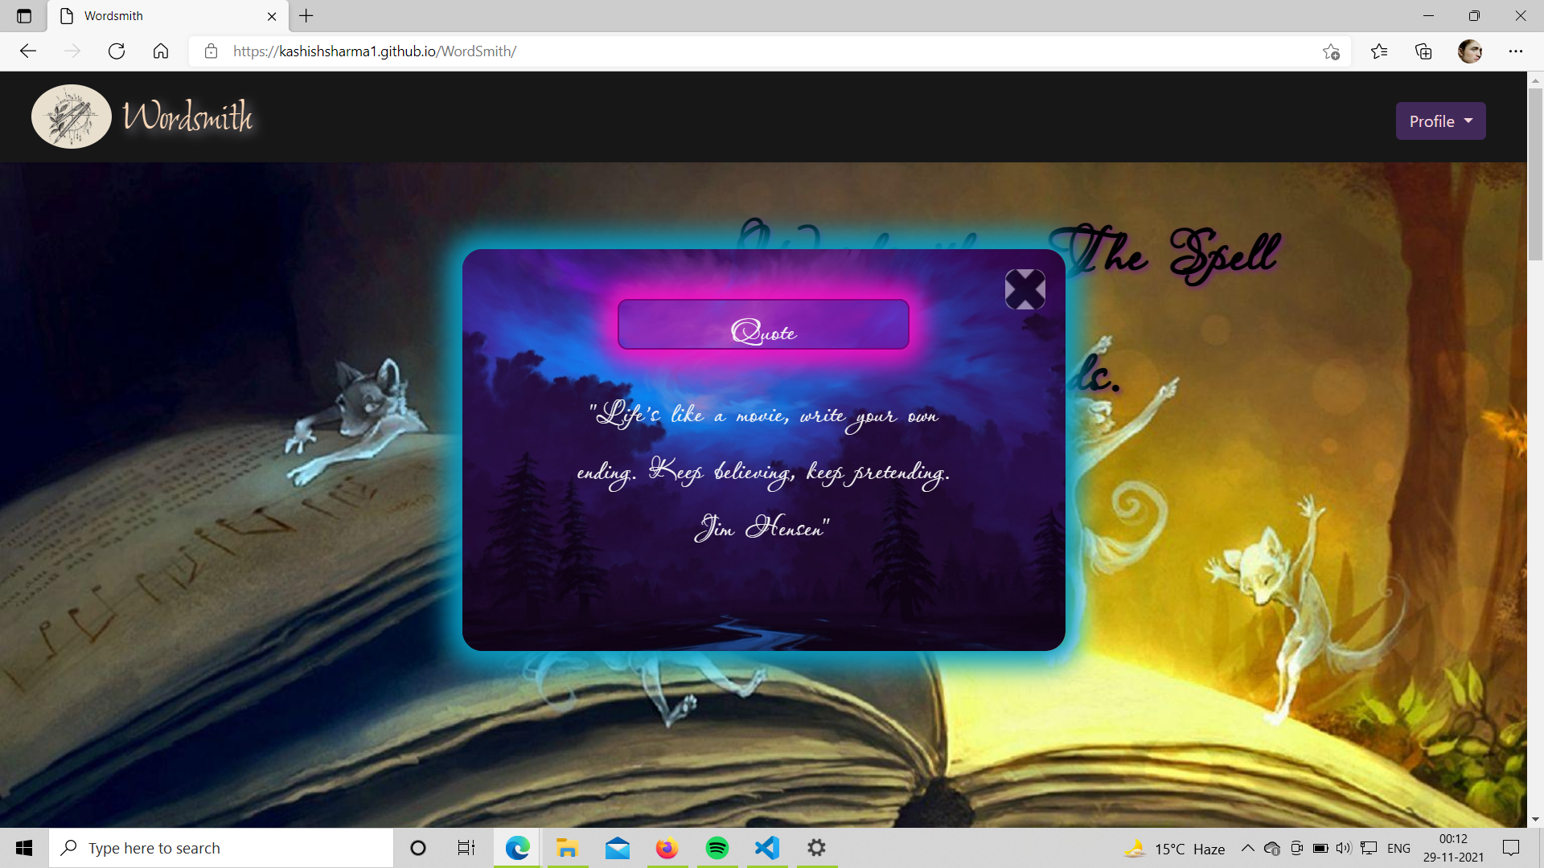

Slide 10
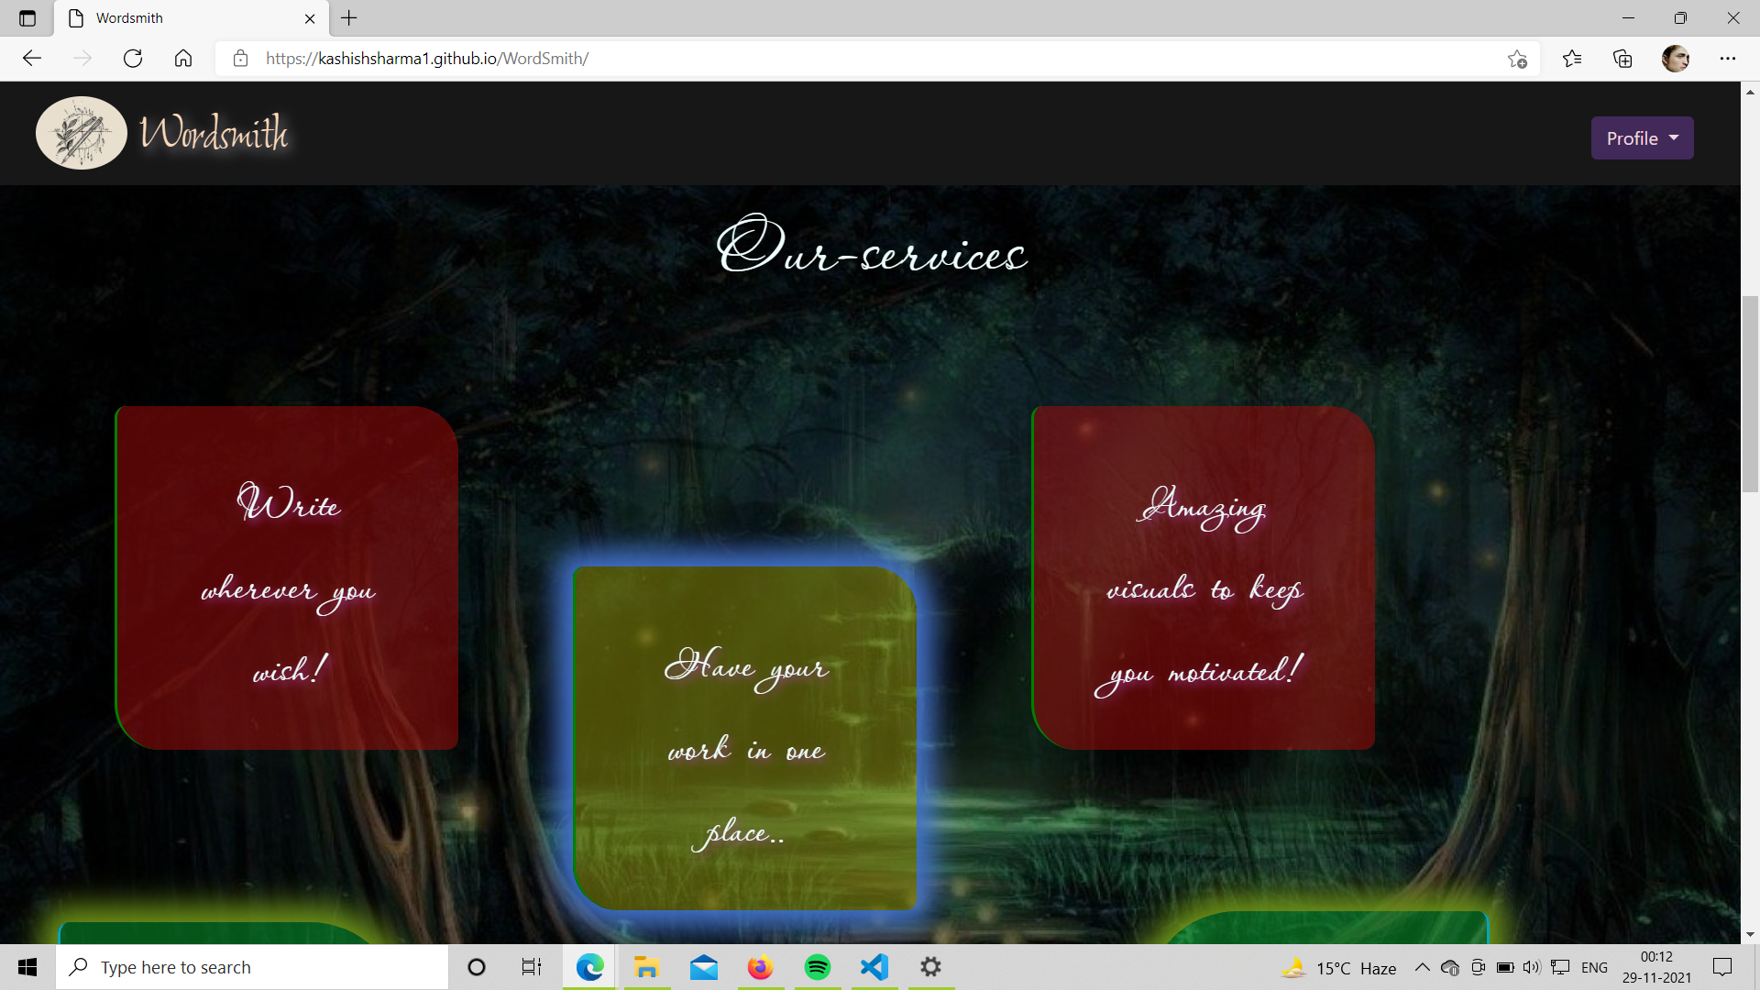

Slide 11
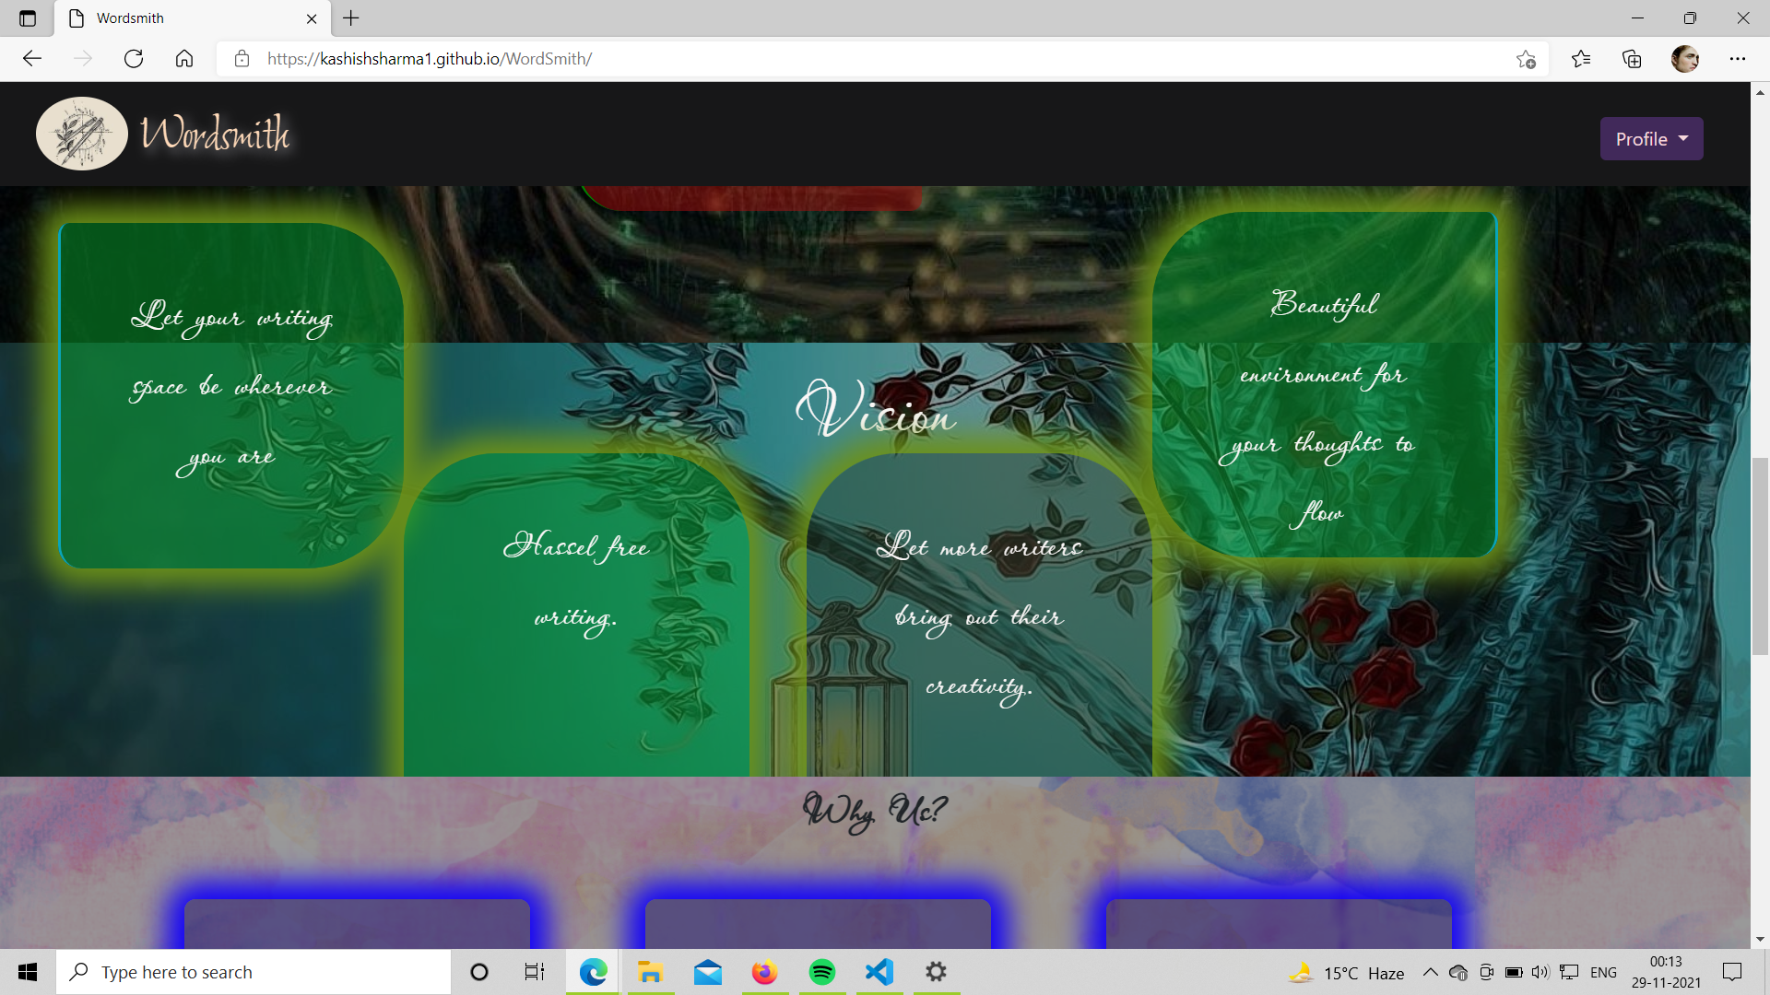

Slide 12
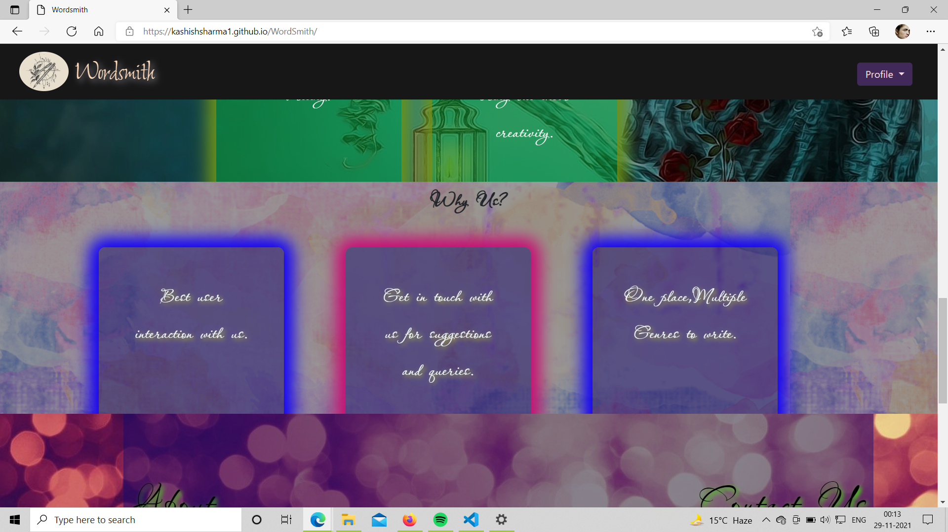

Slide 13
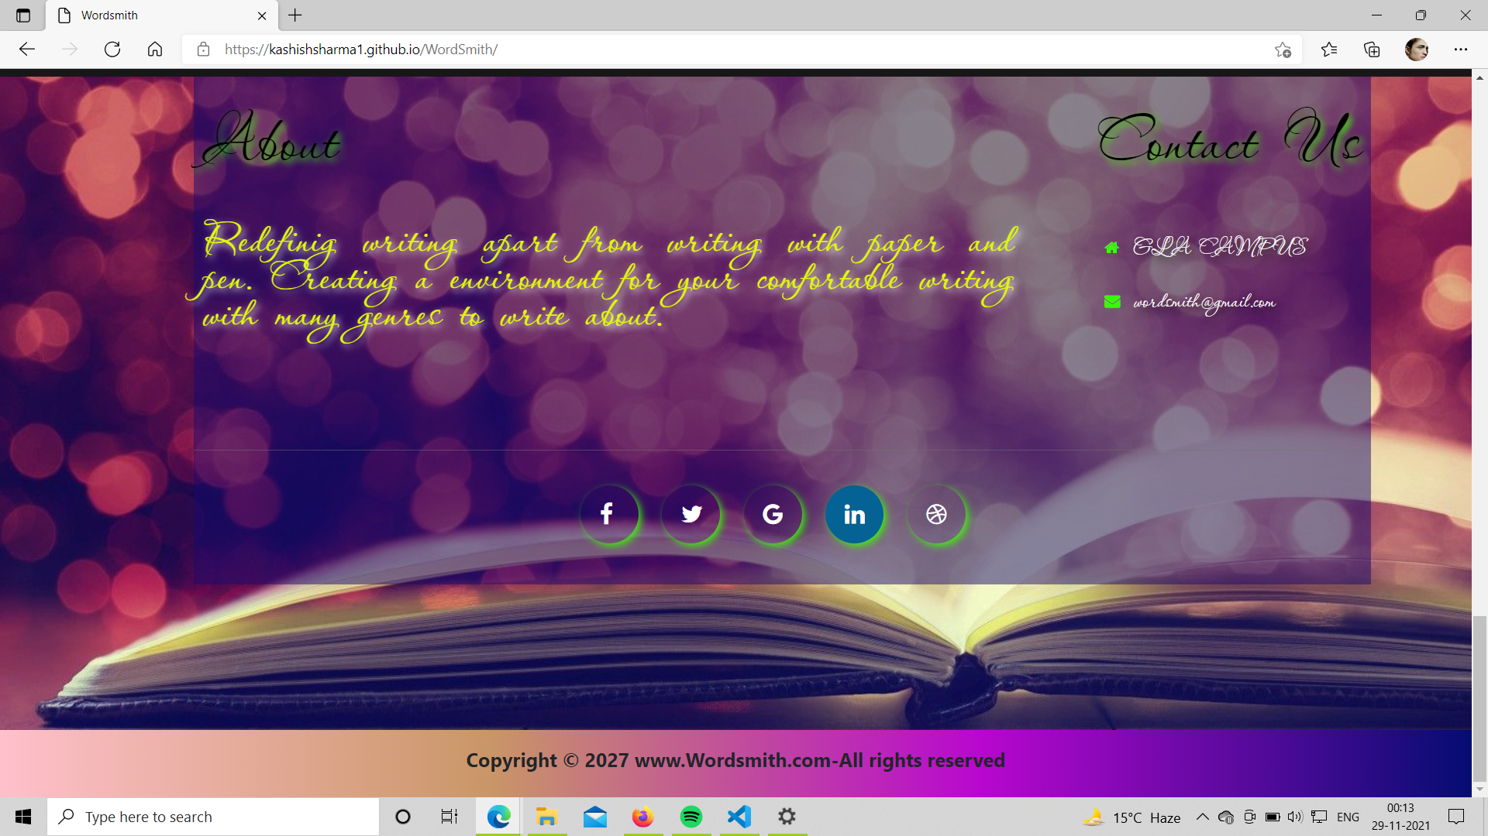

Slide 14
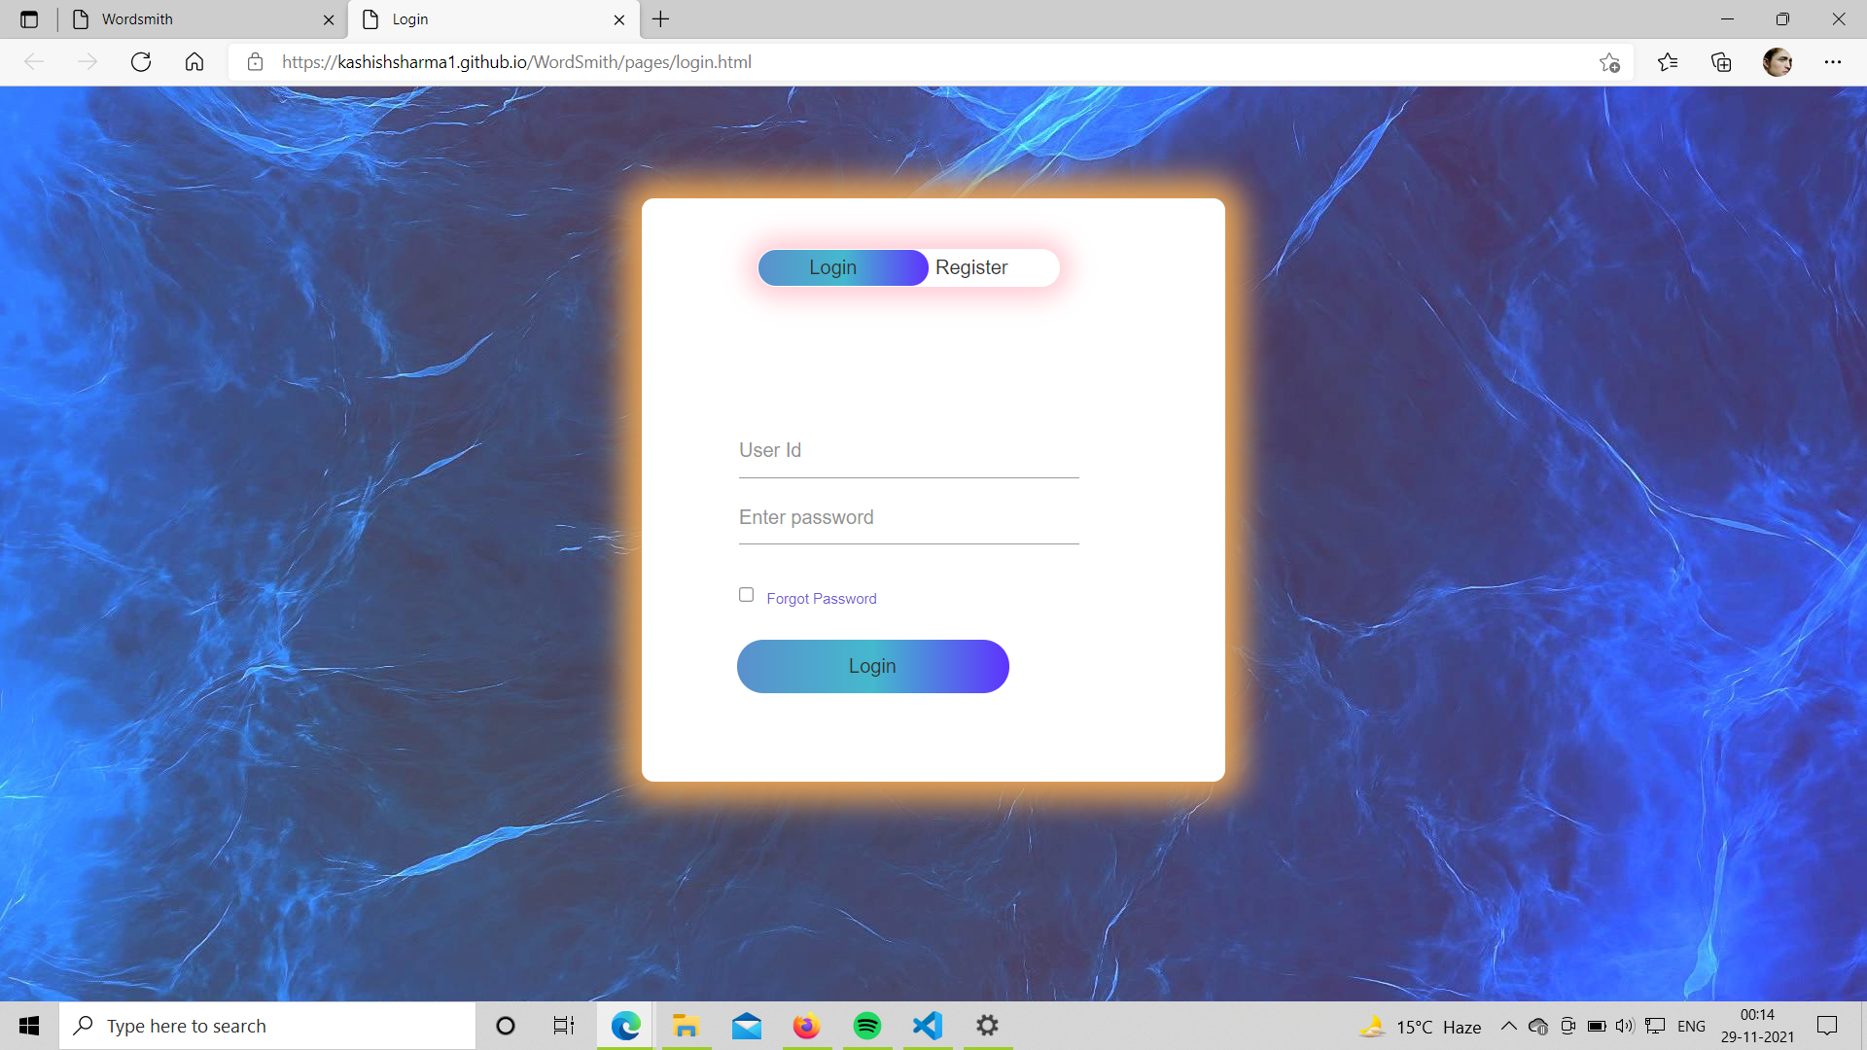

Slide 15
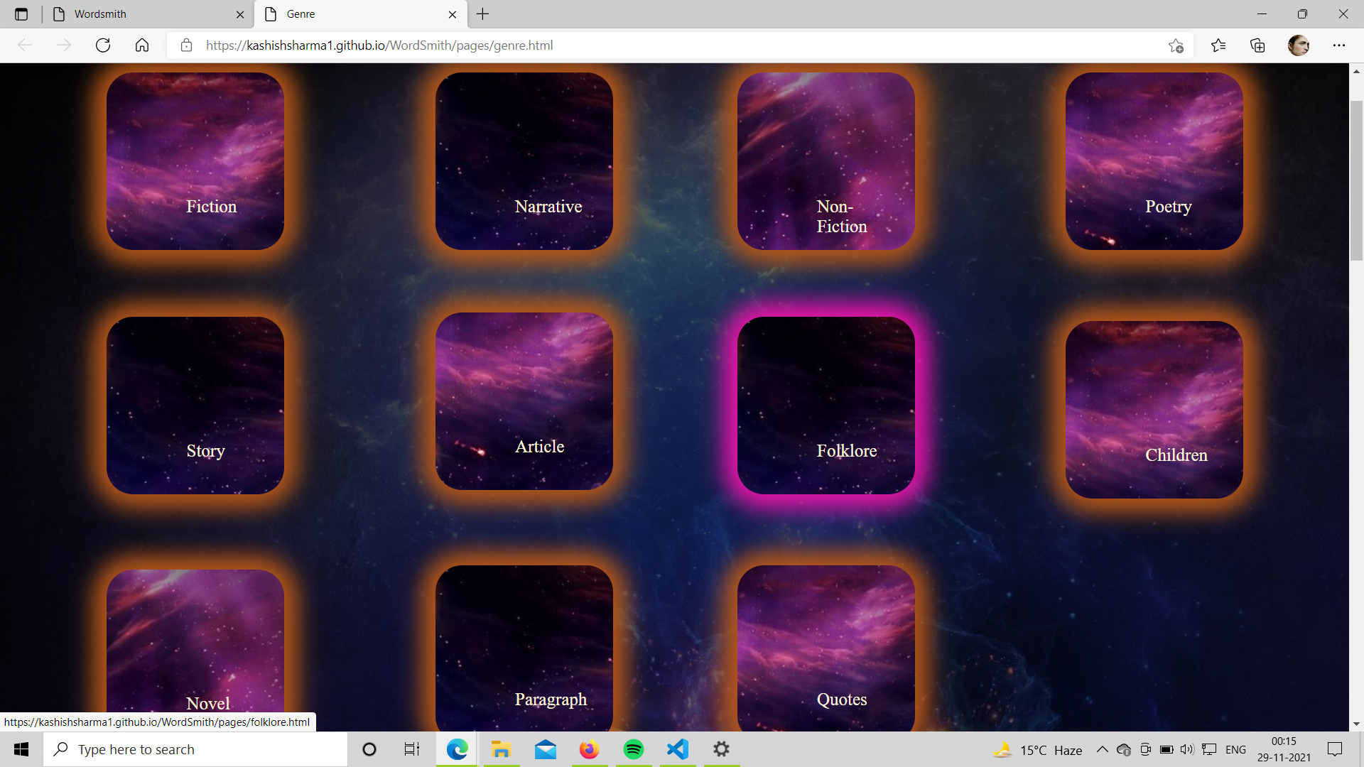

Slide 16
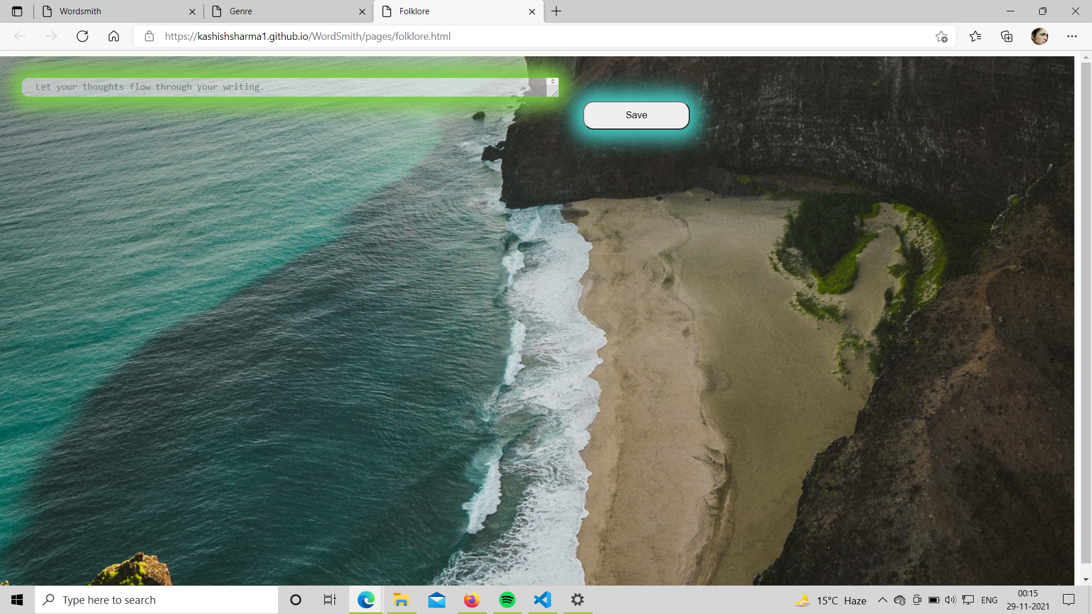

Slide 17
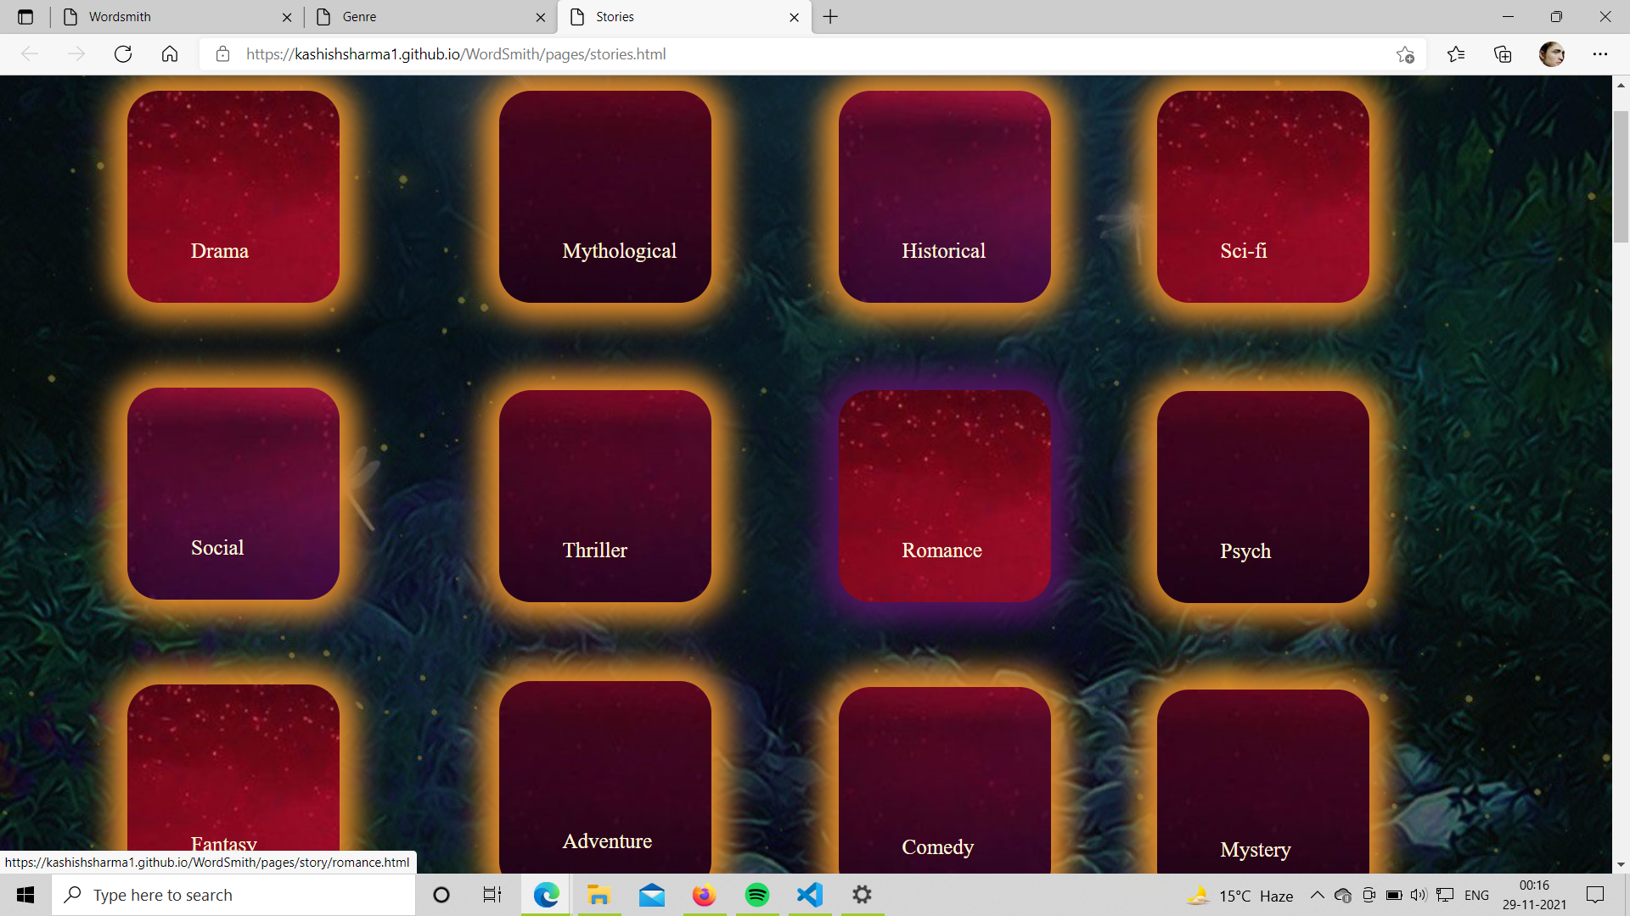

Slide 18
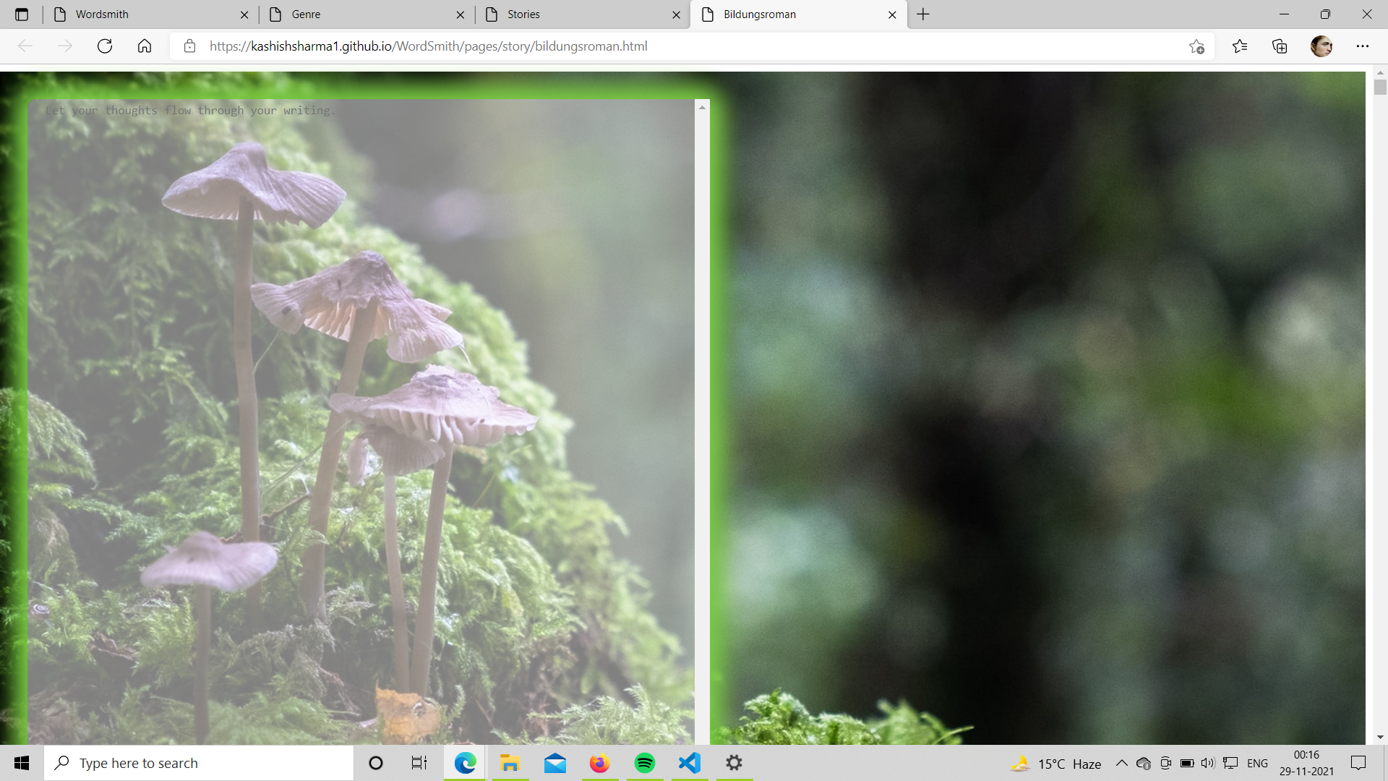

Slide 19
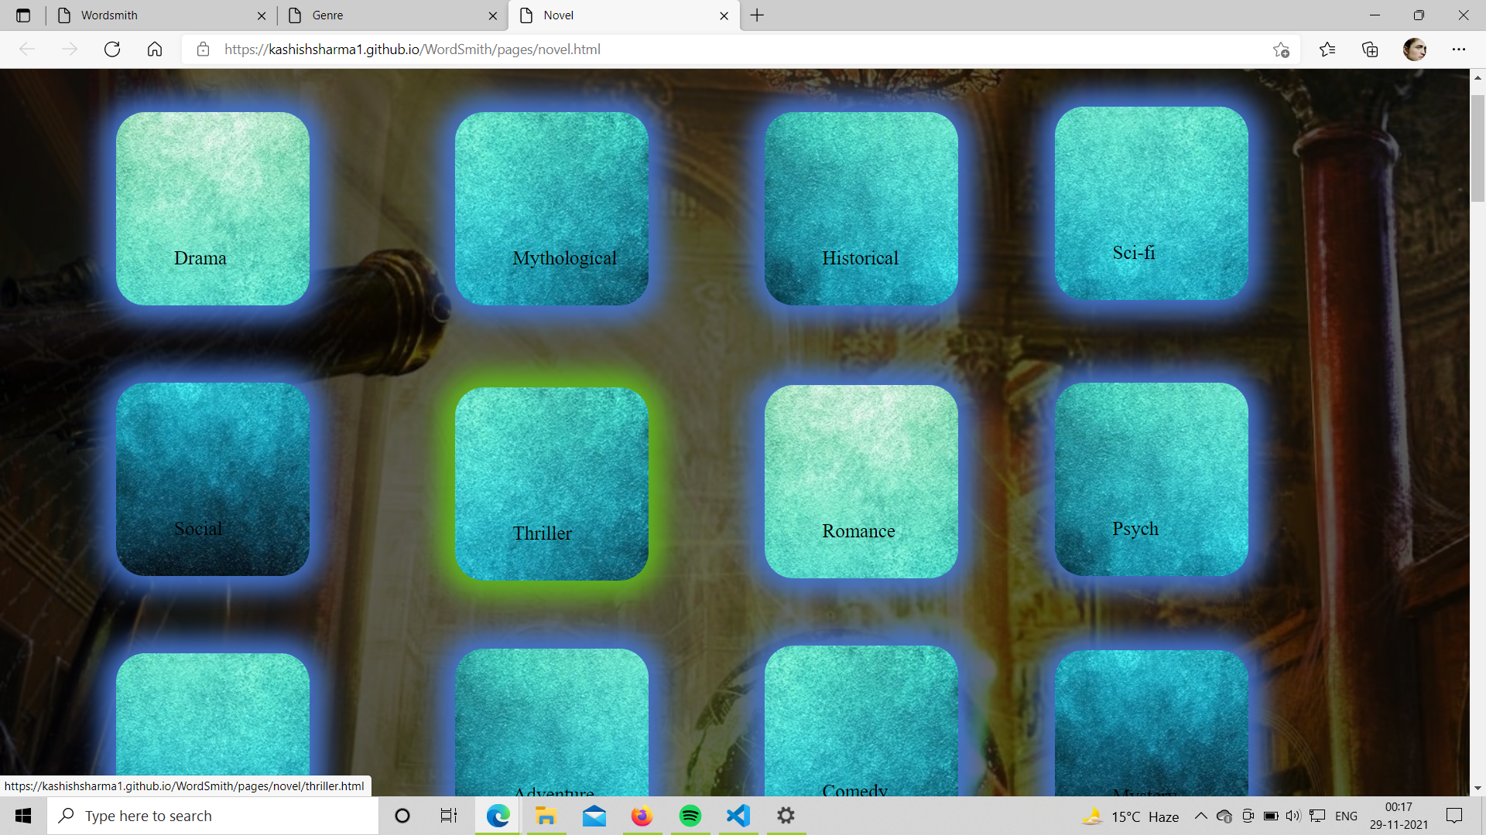

Slide 20
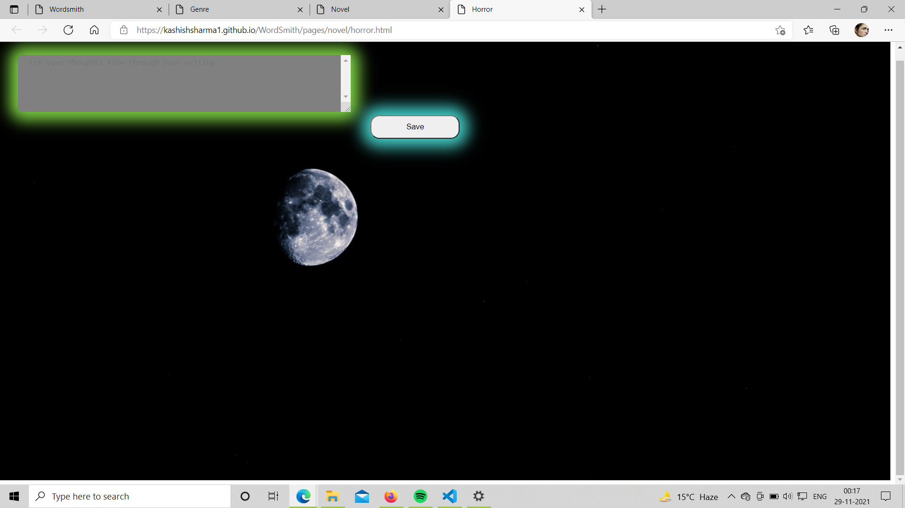

Slide 21
Conclusion
In the recent years, I have realized writing has been so monotonous on notepad and word. So, to bring some excitement while writing your content was the whole motivation behind creating this website.
we need to have a place to keep the resources for areas of our interest so I thought of developing a website which could provide people with their work at one place.

Slide 22
References
https://www.beta-labs.in/
https://www.w3schools.com/
https://youtube.com/
https://www.google.com/

Slide 23
THANK YOU

